Slide 1
Team Lead 3: Quality Assurance
By: Kristie Olds, Nathaniel Palmer, Jeremy Wisecarver, Garrett Wells and Scott Martin

Slide 2
The Unity Test Framework (UTF)
How Unity developers and users test code
Edit-mode testing
Test that can be done before initializing a scene
Test are more simple, typically much faster
Play-mode testing
Test that check scripts at runtime (Update, loops, etc.)
Test can check more complexity, typically much slower
UTF uses Unity’s integration of the NUnit library
Unit-testing framework for all .NET languages (C#, F, PowerShell)
Based off JUnit (java testing)
JUnit is based on the principle of A TRIP

Slide 3
A TRIP
Automatic
Thorough
Repeatable
Independant
Professional

Slide 4
Automatic
All test should run “automatically”
Every test should run with one click
Test suites
A collection of test cases
Typically all test are in a test suite
Occasionally test will be grouped by similar test (smoke test)
Your team should be able to access test easily
Ensures that your teammates code can pass all test before they commit

Slide 5
Thorough
Good test will test as much as possible
Cost-to-benefit ratio
Too much testing can be expensive
Code coverage
Are all execution paths and methods tested?
All public methods should be tested
Private methods can be debated
Scenario coverage
Are all situations being tested?
Specification coverage
Are all requirements being tested?

Slide 6
Repeatable
Test should produce the same results every time
Test should not need modification between uses
Do not test parameters that are uncontrollable
Test would render useless
Time tends to be unexpected
Testing objects that may be deleted earlier in the code

Slide 7
Independent
Test should test one thing at a time
Multiple assertions are okay
They should all test one feature
Test should pinpoint problem location
Test should not rely on each other
There should be no order on how test should be run
A test suite should be able to pass all test in any order

Slide 8
Professional
There should be equal amounts of test code and production code
Code should be well documented
Names should be intention-revealing
There should be no duplication
Readability
Anyone should quickly be able to know what test do
Test should be symmetric

Slide 9
Additional Standards of Testing
Test should be fast
Longer test = Less testing
Less testing = More errors
More errors = Longer debugging
Don’t test code you don’t need to
Code you don’t own
Getters and Setters

Slide 10
Unit Test Definition
Also known as component testing where individual units or components are tested.
This is to make sure that all units of software perform as they are suppose to
A unit is the smallest testable part of any software
Ex: Function, Procedure
In OOP a method is the smallest unit
Fake objects are used to help unit testing
You are essentially using small bits of code to check your code

Slide 11
Why should I use unit tests?
It’s an easy way to make better code faster
It helps instill confidence in the coder
It promotes consistency
It will just make life easier

Slide 12
Unit Tests
Unit tests should follow as you saw earlier A TRIP
Automatic
Thorough
Repeatable
Independent
Professional

Slide 13
Automatic
You shouldn’t need to know how the rest of your group’s code works
The unity test framework is there to make sure that everything is working
It will automatically tell you if you broke any of the code and can tell you if everything works as intended
The unity test framework also allows you to quickly and easily run all of your tests with the press of a button

Slide 14
Thorough
Your tests should cover all of your boundary cases
Boundary case Def:
The behavior of a system when one of its inputs is at or just beyond its maximum or minimum limits
Your tests should also cover anything you think might be liable to break
How thorough your testing is in many cases is a pure judgement call
Do not test “Getters” or “Setters”

Slide 15
Repeatable
Your tests should not have variables that are out of your control
Your tests will be rendered useless if the results of the test change regularly
Exceptions might be random variables in your stress test
Do not make the failure condition directly dependent on the random variable

Slide 16
Independent
Your tests should only be testing one thing at a time.
If you don’t only test one thing at a time you will run into a specific problem
You won’t know precisely where your code failed a test
Unit-testing being independent tells you what you broke
Either in someone else’s code or your own

Slide 17
Professional
Unit-test code should be written professionally
Code we write for unit tests is just as real as the code in the final product
If you find yourself reusing code over and over you should use methods
Fight the urge to treat test-code as a second class type of code
The test-plan part is a part of the oral exam
Dr. BC will be looking for professional looking code

Slide 18
Other requirements of your Unit-tests
Unit-tests should run very fast
The longer unit-tests take to run the less often they will be run
The Unit-tests should be readable
The less readable a unit test is the more difficult it is to fix issues when they arise.

Slide 19
Unit testing weakness
How do you test your unit-tests?
You do not unit-test your unit-tests
Deal with unit-tests when you fix bugs
If a bug isn’t caught by the unit-test this bug went through a hole in your unit-test safety net
Try introducing bugs yourself to find weaknesses in your unit-tests

Slide 20
Without unit tests
You are building a “house of cards”
The time to complete a project becomes unpredictable
You are required to know all of your code forward and backwards
We don’t know if the code is doing what is required of it
Boundary conditions might not be functioning properly

Slide 21
Install Unity Test Framework
From open project, select Window → Package Manager
From sources select “Packages: Unity Registry”
Search “Test Framework”
Install

Slide 22
Unit Test Example
Set up a Unit Test directory
Use assemblies to setup references
Create an edit mode test script
Create a play mode test script
Ways to determine test success and failure

Slide 23

What Is Integration Testing?
Combining the Unit Test Modules into a interface to verify all modules work together correctly

Slide 24
3 Important Parts of Integration Testing
Verifies all modules work together
Reveals underlying errors in the interfacing
Verifies any newly added components aren’t affected

Slide 25
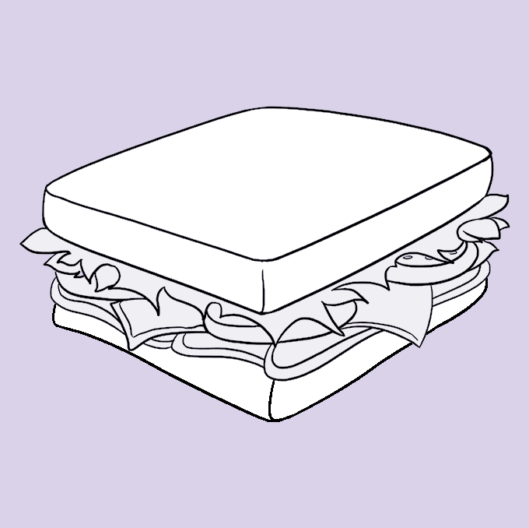
The Four Approaches
Top-Down Bottom-Up Big-Bang Sandwich

Slide 26
Top - Down Integration Test
Testing starts from a high level module to Low Level
Pros
Very consistent
Takes less time
Location of fault is easier
Major flaw detection
Cons
May require several stubs
Early release support is not good
Testing for basic functionally occur late

Slide 27
Bottom - Up Integration Test
Testing starts from a low level module to high Level
Pros
Application efficient
Less time required
Easier test conditions for the creation process
Cons
Necessary to have several drivers
Testing for data flow is late
Early release is poorly supported
Detection late of key interface defects

Slide 28
Big - Bang Integration Test
All modules are tested as a whole
Pros
Everything tested at once
Easy for small systems
Testing time is saved
Cons
Takes a while to set up
The root causes of failures is harder to track
Chances of interface links missing
Important modules aren’t prioritized

Slide 29
Sandwich Integration Approach
Make use of both Top-Down and Bottom-Up testing with a middle layer as the target
Pros
Layers can be tested simultaneously
Cons
It’s spendy
Requires higher skill level
Not as extensive testing

Slide 30
What makes a good Integration Test
The idea behind Integration Testing is to combine parts of the application and test as a group to see that they work together.
In doing this, you expose interaction faults between components and improve the program as a whole.

Slide 31

Making an integration test

Slide 32
What is a Stress Test
The goal of a stress test is to find the limit at which the program breaks and how it handles crash errors. It also gives valuable information about how the program works when the situation is less than ideal or unexpected.
Plan what element you want to test
Where do you think your biggest bottleneck is?
Write a script to test it
Run the script and get your results
Did it meet your expectations? If not, optimize and re-run the test

Slide 33
How to make a stress test

